Slide 1
Architecting AWS problem description

Slide 2
DocStore
A company called aMedia wants a new web site to be created.
The web site is called DocStore
DocStore allows customers to upload and manage their documents in the cloud
  Upload and access content from anywhere
    Browser and mobile apps
  Supports different types of content
    PDF, office docs, images, videos
      Text content extracted, indexed and searchable

Slide 3
Two Account Types
Free
  5 GB storage
  No full-text indexing
  Can search on the following:
    name, created/modified date and tags
  All content may be securely downloaded by owner
Premium
  20 GB storage
  Full-text indexing and search for all documents + optical character recognition for images.
  All content may be securely downloaded by owner

Slide 4
Requirements
Web Application
  Allow users to upload, manage and view all documents
  All content uploaded directly to S3
DocStore API
  Allows programs to directly access DocStore contents without using web application
Web application directly uses the DocStore API
System must scale
System must be highly available

Slide 5
Deployment
Multi-region deployment for global support
  Sydney and Oregon
User can log into any region
  Always redirected to “home” region (i.e. region where account was created)

Slide 6
Some things to think about
Password storage
User session information storage
Storage of static content
  E.g. company logo on web page
Storage of actual content
  E.g. pictures, pdfs, etc. uploaded by the users.
Searching and indexing of content
High availability
Low latency access by users
Elasticity
Handle the different types of accounts differently.
Etc.
Draw diagrams for your solution

Slide 7
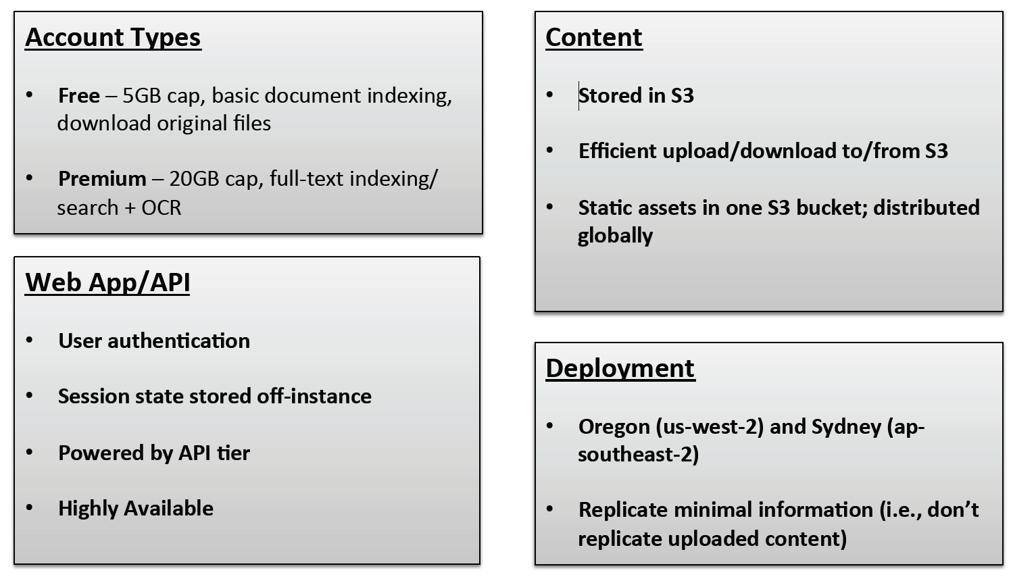
DocStore Requirements

